Slide 1
Bring Down Cost & Production Time With
SAP BPM Service

Slide 2
Why To Use SAP BPM Service?
Improve your business segments including finance & accounting, budgeting, planning, financial reporting, etc.
Helps raising quality of product and service
Customer Orientation, Team Work, Responsibility

Slide 3
Apprisia's SAP BPM Workflow Assurance
Accurate Implementation Fast Implementation Low Cost

Slide 4
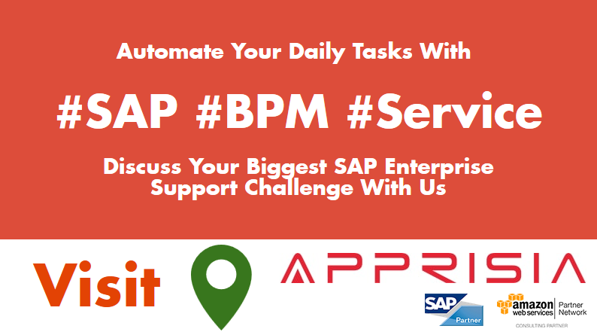
To Get More Details, Hire Our SAP Basis Consultants or Call at (214) 556 5416

